Slide 1
IT627 – Cloud Computing

Slide 2
Course Information
Grading Scheme
Project based / Hands-on work evaluation
Evaluation of practical implementation of technologies discussed in lectures
Source code / work to be saved on GitHub
No written examination

Slide 3
Course Information
Course Plan
Cloud Computing – Developer perspective
Cloud Computing – Architect perspective
Cloud Computing – IT perspective
Cloud Service Providers
Azure
References
Online material (like here, here and here).
No single reference book

Slide 4
Course Lab
Goal – Implement concepts on projects that you are working on

Slide 5
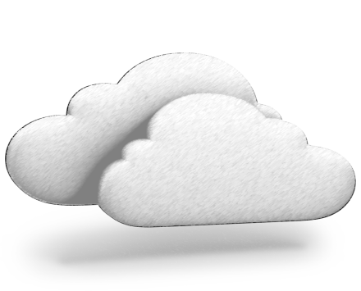
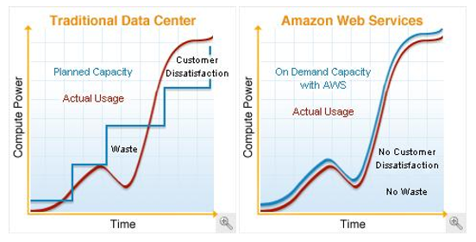
Cloud Computing
BUILDING BLOCKS
Definition
“Cloud computing is a specialized form of distributed computing that introduces utilization models for provisioning and measured resources
Business Drivers (i.e. motivation)
Capacity Planning
Cost Reduction
Organizational Agility
remotely
scalable
and platform services
”.
Organizational agility is the measure of an organisation’s responsiveness to change.
IT enterprise needs to respond to business change by scaling its IT resources beyond what was predicted or planned.
New business requirement for IT resources to be more available & reliable than before.
Budget constrains scales down up-front investments in IT and makes it vulnerable to such risks.
IT support of new and expanded business automations an ever-increasing investment
Two costs need to be accounted for:
Cost of acquiring new infrastructure
Operational / maintenance cost
Operational overhead represents for large share of IT budgets
Operation overheads – technical manpower, upgrades & patches, utility bills – power & cooling, security & access control, administrative & accounting (licensing etc.)
Lead Strategy – adding capacity to an IT resource in anticipation of demand.
Lag Strategy – adding capacity when the IT resource reaches full capacity
Match Strategy – adding IT resource capacity in small increments as demand increases.
Problems:
Accommodate Max Load – over expenditure
Moderating expenditure – transaction losses & usage limitations.
Notes:
Capacity planning – irctc tatkal booking overload. Add capacity by increasing servers – un/underutilized during non-peak hours.
Cost – acquiring new infra & ongoing / maintenance cost

Slide 6
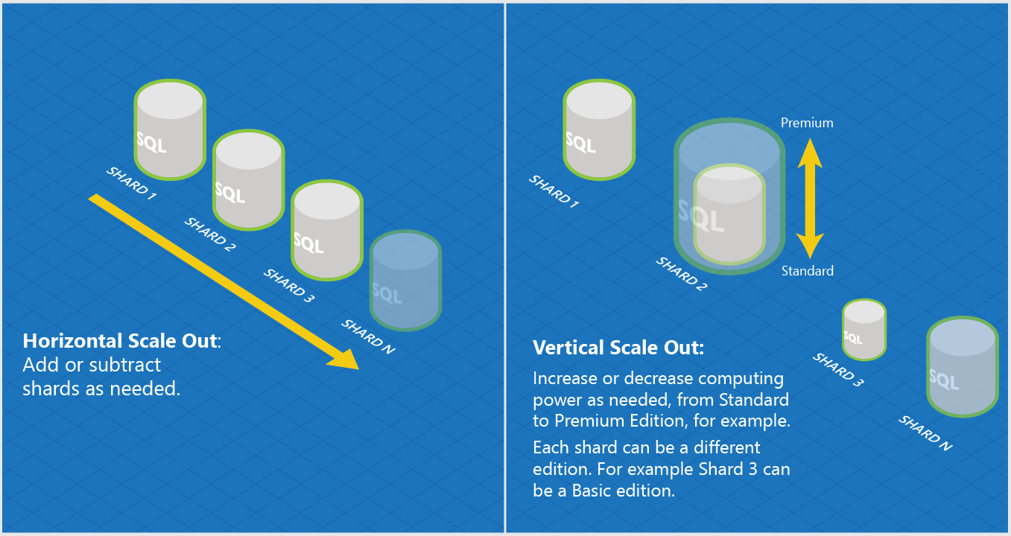
Basic Concepts & Terminologies
BUILDING BLOCKS
Cloud (same as internet?)
IT Resource
On-Premise
Cloud Consumers & Cloud Providers
Scaling
Vertical (Scale Up)
Horizontal (Scale Out)
Cloud Service
Cloud Service Consumer

Slide 7
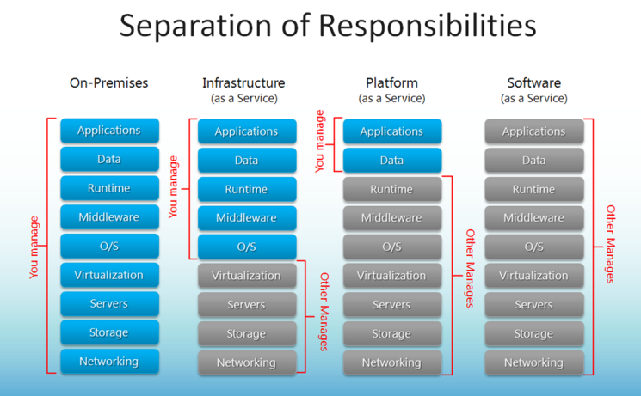
Cloud Delivery Models
BUILDING BLOCKS
IaaS – Infrastructure as a Service
PaaS – Platform as a Service
SaaS – Software as a Service
Combining Cloud Delivery Models
Notes:
Is website in old days a SaaS?

Slide 8
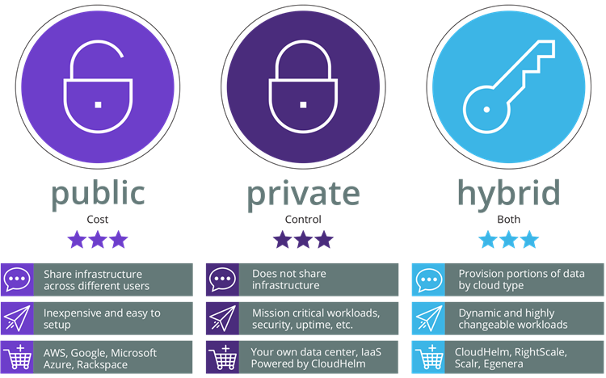
Cloud Deployment Models
BUILDING BLOCKS
Public Cloud
Private Cloud
Hybrid Cloud
Community Cloud

Slide 9
Cloud vs Traditional
Traditional (on-premises) Systems
Cloud based Systems
Monolithic, centralised
Design for predictable scalability
Relational database
Strong consistency
Serial and synchronised processing
Design to avoid failures (MTBF)
Occasional big updates
Manual management
Snowflake servers
Deconstructed, decentralised
Design for elastic scale
Polyglot persistence (mix of storage technologies)
Eventual consistency
Parallel and asynchronous processing
Design for failure (MTTR)
Frequent small updates
Automated self-management
Immutable infrastructure

Slide 10
Cloud Provider – AWS
BUILDING BLOCKS
Amazon Web Services
AWS World
AWS Organizations
AWS Account
AWS Account
OU: Admins
SCP: Admin
AWS Account
OU: Dev
AWS Account
AWS Account
AWS Account (Master)
SCP: DevTest
AWS Company Account
OU: Test
AWS Account
AWS Account
Notes:
SCP – Service Control Policy

Slide 11



AWS – IAM vs Organizations
BUILDING BLOCKS
IAM (Identity and Access Management)
Organizations
AWS Account
Root A/C
AWS Account
Test Policy
Dev Policy
Test SCP
Dev SCP
Billing & Usage
Test Team
Dev Team
Test OU
Dev OU
AWS A/C
AWS A/C
Organization
Groups
Prod OU
Prod Team
AWS A/C
Prod Policy
Prod SCP

Slide 12
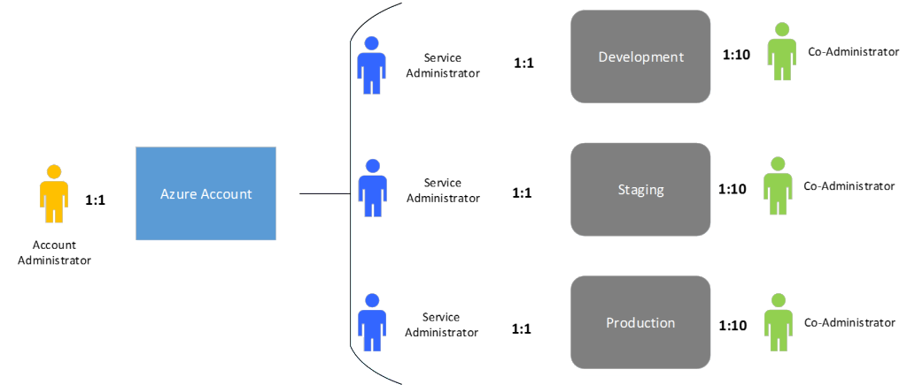
Cloud Provider – Azure
BUILDING BLOCKS
Azure World
<id>@Hotmail.com; <id>@outlook.com; <id>@live.com;
Used for accessing various Microsoft services.
Subscriptions
$
Microsoft Account
$
Organizational Account
$
<id>@<org name>.onmicrosoft.com => Gives a unique domain for accessing Azure services for the org.

Slide 13
Quiz time!
BUILDING BLOCKS
Q. The SQL database instance in cloud is throttling. I move it from Standard tier to Premium tier. This move is an example of Horizontal or Vertical scaling?
A. Vertical scaling.
Q. I need to create my resume for placement interviews. I run MS Word online through Office 365 subscription to create my resume. This is an example of IaaS/PaaS/SaaS?
A. SaaS.
Q. I provisioned (created) an VM instance in my AWS cloud for installing a web server. This is an example of IaaS/PaaS/SaaS?
A. IaaS
Q. My company has multiple AWS accounts for running its business in AWS cloud. So many accounts are causing access and tracking confusions. My boss just asked me to look for a solution in AWS. What is that solution?
A. Use AWS organizations to create OUs & assign SCPs and make one AWS account as master account for that organization. The billing then will happen against that master AWS account.
Q. In Azure, an Azure subscription can have multiple Azure accounts. True or false?
A. False. An Azure account can have multiple subscriptions but not vice versa.
Q. In Azure, I create my Azure account and then created a VM under it. All good. True or False?
A. False. Without first creating a subscription, no resources can be created under an Azure account.

Slide 14
Data Centres Technology - AWS
BUILDING BLOCKS
Global scope (eg. AWS Account)
Amazon Web Services
Region
Regional scope (eg. EC2 Instance ID)
Regions are completely isolated from other regions
Greatest possible fault tolerance & stability
Will not replicate resource across regions automatically
Charge for data transfer across regions
Availability Zone
Region
Zone scope (eg. EC2 Instance)
Availability Zone maps to one or more physical data centre (facility) of Amazon.
AZs are connected to each other with fast, private FO networking.
Distribute instances across AZs for continuity of application.
Availability Zone
Availability Zone
dc
dc
Availability Zone
Availability Zone
Notes:
1. Resources viewable only by region.
2. AZs have to be chosen, either by user or by AWS.
3. Distribute instances across multiple Azs, one fails – redirect to another. Design app such a way.
4. AZ 3 letter identifier us-east-1a. Location of us-east-1a may not be same for two accounts
5. Constrained Azs, removed Azs. Azs in two accounts could be differet.

Slide 15
Data Centre Technology - Azure
BUILDING BLOCKS
Azure
Storage data is triplicated in region and it’s paired region
Availability set is created by user. SLA of 99.95% holds only if two or more VMs are put in an AvSet.
Fault Domains – up to 3 per AvSet.
Update Domains – up to 5 (20 via RM) per AvSet.
Azure Region
Azure Region
Location
Location (dc, hardware cluster)
> 480 Km
FD 0
FD 1
FD 2
VM1
VM2
VM3
Availability Set
VM4
VM5
VM6
Azure Region
(Paired)
Same Update Domain
VM7
VM8

Slide 16
Resource Management in Azure
Azure Resource Manager
enables working with the resources in your solution as a group.
can deploy, update, or delete all the resources for a solution in a single, coordinated operation.
use a template for deployment and that template can work for different environments such as testing, staging, and production.
provides security, auditing, and tagging features to help manage resources after deployment

Slide 17
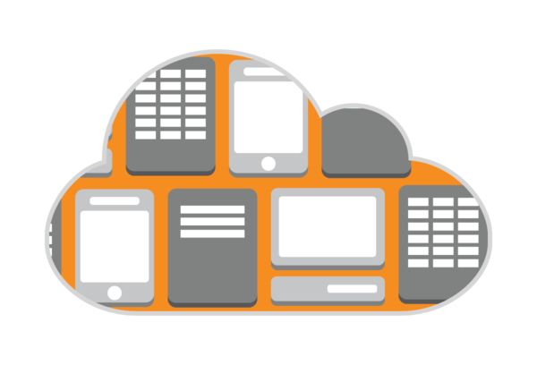
N-Tier Architecture - IaaS

Slide 18
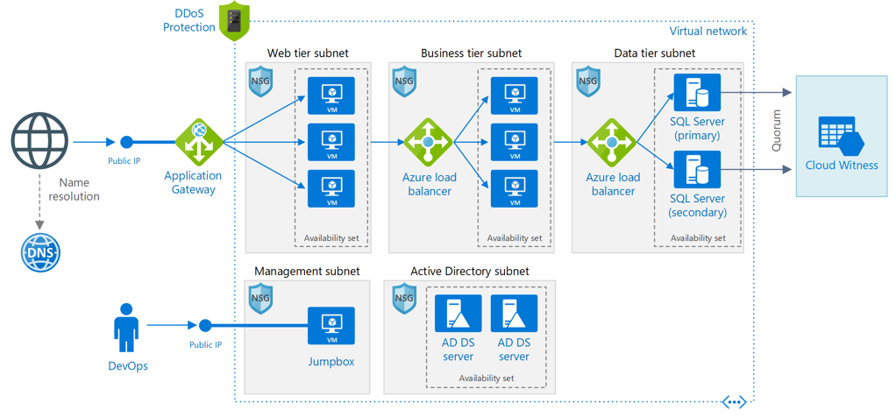
N-Tier Application Architecture In A Region
Notes:
The architecture has the following components (https://docs.microsoft.com/en-us/azure/architecture/reference-architectures/n-tier/n-tier-sql-server):
Resource group. Resource groups are used to group resources so they can be managed by lifetime, owner, or other criteria.
Virtual network (VNet) and subnets. Every Azure VM is deployed into a VNet that can be segmented into subnets. Create a separate subnet for each tier.
Application gateway. Azure Application Gateway is a layer 7 load balancer. In this architecture, it routes HTTP requests to the web front end. Application Gateway also provides a web application firewall (WAF) that protects the application from common exploits and vulnerabilities.
NSGs. Use network security groups (NSGs) to restrict network traffic within the VNet. For example, in the three-tier architecture shown here, the database tier does not accept traffic from the web front end, only from the business tier and the management subnet.
DDoS Protection. Although the Azure platform provides basic protection against distributed denial of service (DDoS) attacks, we recommend using DDoS Protection Standard, which has enhanced DDoS mitigation features. See Security considerations. Provides additional mitigation capabilities over the Basic service tier that are tuned specifically to Azure Virtual Network resources.
Virtual machines. For recommendations on configuring VMs, see Run a Windows VM on Azure and Run a Linux VM on Azure.
Availability sets. Create an availability set for each tier, and provision at least two VMs in each tier, which makes the VMs eligible for a higher service level agreement (SLA).
Load balancers. Use Azure Load Balancer to distribute network traffic from the web tier to the business tier, and from the business tier to SQL Server.
Public IP address. A public IP address is needed for the application to receive Internet traffic.
Jumpbox. Also called a bastion host. A secure VM on the network that administrators use to connect to the other VMs. The jumpbox has an NSG that allows remote traffic only from public IP addresses on a safe list. The NSG should permit remote desktop (RDP) traffic.
SQL Server Always On Availability Group. Provides high availability at the data tier, by enabling replication and failover. It uses Windows Server Failover Cluster (WSFC) technology for failover.
Active Directory Domain Services (AD DS) Servers. The computer objects for the failover cluster and its associated clustered roles are created in Active Directory Domain Services (AD DS).
Cloud Witness. A failover cluster requires more than half of its nodes to be running, which is known as having quorum. If the cluster has just two nodes, a network partition could cause each node to think it's the master node. In that case, you need a witness to break ties and establish quorum. A witness is a resource such as a shared disk that can act as a tie breaker to establish quorum. Cloud Witness is a type of witness that uses Azure Blob Storage. To learn more about the concept of quorum, see Understanding cluster and pool quorum. For more information about Cloud Witness, see Deploy a Cloud Witness for a Failover Cluster.
Azure DNS. Azure DNS is a hosting service for DNS domains. It provides name resolution using Microsoft Azure infrastructure. By hosting your domains in Azure, you can manage your DNS records using the same credentials, APIs, tools, and billing as your other Azure services.

Slide 19
Role of Application Gateway
Web traffic load balancer enables us to manage traffic to our web applications
Operates at application level (OSI level 7 - Application).
Traditional load balancers operate at transport layer (OSI level 4 – TCP & UDP) and route traffic based on IP address and port.
Application Gateway can route traffic based on URL
SSL termination
supports terminate encryption at gateway, so data travels un-encrypted to the backend servers. Saves overhead.
Web application firewall – protection against common exploits
Multiple site hosting, Redirection, Session affinity etc.

Slide 20
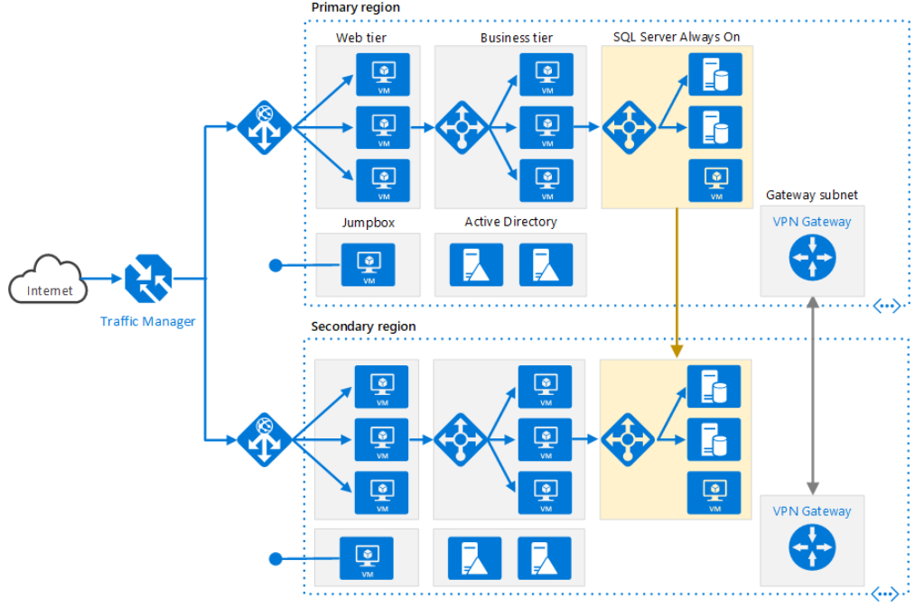
N-tier architecture – Multi-region deployment
Notes:
Azure and AWS comparison:
https://docs.microsoft.com/en-us/azure/architecture/aws-professional/
https://docs.microsoft.com/en-us/azure/architecture/aws-professional/services

Slide 21
Role of Traffic Manager in Multi-region deployment
Traffic Manager allows users to control traffic distribution across various application endpoints.
The Traffic Manager distributes the traffic using the configured routing method
Priority, Weighted, Performance, Geographic
Constant monitoring of the endpoint health.
Automatic failover in case the endpoints fail.
Functions at the DNS level. It uses the DNS to route clients to precise service endpoints, according to the traffic-routing rules and methods.
Traffic Manager operation modes:
Active | Passive – hot failover
Active | Passive – cold failover
Active | Active – load balanced

Slide 22
AZURE AUTOMATION USING AZ CLI

Slide 23
az cli
The CLI is a tool designed to get you working quickly and efficiently with Azure services, with an emphasis on automation
Works on Windows, Mac OS, Linux
Can also be run in Azure portal as cloud shell
Sign In
az login

Slide 24
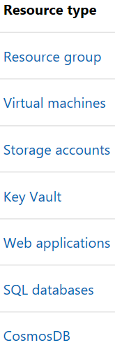
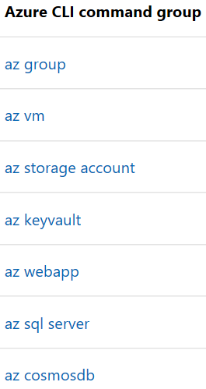
Common Commands
Commands in the CLI are organized as commands of groups.
Each group represents an Azure service, and commands operate on that service.

Slide 25
Globally available arguments
--help prints CLI reference information about commands and their arguments and lists available subgroups and commands.
--output changes the output format. The available output formats are json, jsonc (colorized JSON), tsv (Tab-Separated Values), table (human-readable ASCII tables), and yaml. By default the CLI outputs json. To learn more about the available output formats, see Output formats for Azure CLI.
--query uses the JMESPath query language to filter the output returned from Azure services. To learn more about queries, see Query command results with Azure CLI and the JMESPath tutorial.
--verbose prints information about resources created in Azure during an operation, and other useful information.
--debug prints even more information about CLI operations, used for debugging purposes. If you find a bug, provide output generated with the --debug flag on when submitting a bug report.

Slide 26
Creating a virtual machine using az cli
az login
In Azure, all resources are allocated in a resource management group.
Resource groups provide logical groupings of resources that make them easier to work with as a collection.
Create a resource group
az group create –name mscit2018 –location centralindia
Create a vm under resource group
az vm create --resource-group mscit2018 --name testvm1 --image ubuntults --admin-user lavneetsingh --generate-ssh-keys --verbose --output json

Slide 27
az vm show --name testvm1 --resource-group mscit2018
az group delete --name mscit2018 --no-wait
az group wait --name mscit2018 --deleted

Slide 28
Cloud Storage

Slide 29
Scenario: Disks & File system in cloud for VMs
VMs in cloud need disk drive for
Operating System
Temporary Data
Data storage
Applications running on VMs may also want to access files in a file system just like they do while running on actual h/w machine. Important for
cloud migration
shared file stores
developer tools etc.

Slide 30
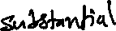
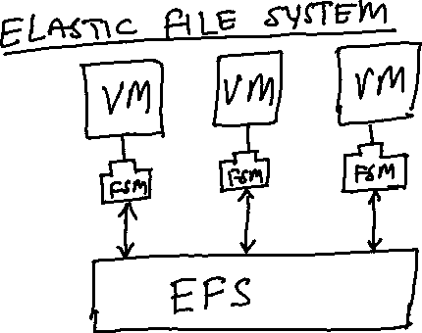

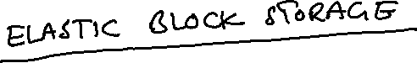
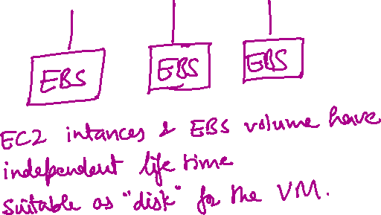
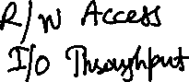
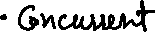
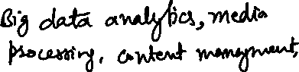
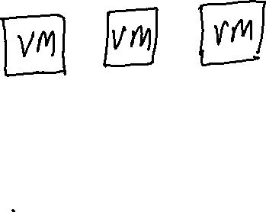
AWS Solution: EFS & EBS

Slide 31
Azure Solution: Azure Disks & Azure Files
Azure Files offers fully managed file shares in the cloud that are accessible via the Server Message Block (SMB) protocol.
ideal replacement for file shares on-premises
Azure file shares can be mounted concurrently by cloud or on-premises deployments of Windows, Linux, and macOS.
share a file system across multiple machines, applications/instances.
Azure file shares can be cached on Windows Servers with Azure File Sync for fast access near where the data is being used.
Azure Disks: OS disk, Temporary disk, Data disk. Unmanaged and Managed disks. Always use managed disks
Notes:
Unmanaged disks are the traditional type of disks that have been used by VMs.
Managed Disks handles the storage account creation/management in the background for you, and ensures that you do not have to worry about the scalability limits of the storage account. You simply specify the disk size and the performance tier (Standard/Premium), and Azure creates and manages the disk for you.

Slide 32
Scenario: Serving Static web content and media
Static web content typically include HTML pages and other resources like images, video and documents – scripts, pdf downloads etc.
Although web servers are well tuned to optimize requests through efficient dynamic page code execution and output caching, they still have to handle requests to download static content.
This means spending money on CPU cycles
GOAL: Minimise need for compute instances

Slide 33
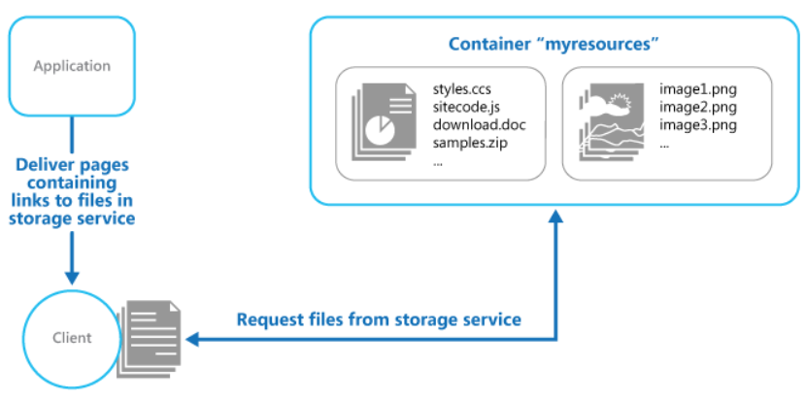
Solution: URL based storage service
Need to take care of –
Security
Read/Write access
Deployment

Slide 34
AWS Solution: Amazon S3 (Simple Storage Service)
Store data objects from 1 byte to 5 TB of data.
Each object has its public / access URL
Highly scalable – allows concurrent read and write access to data by many separate clients or application threads
In same region using S3 with EC2 instance (ie. a VM) is designed to be fast.
Can’t be used in place of file system
Can’t query data
Not suitable for very rapidly changing data
Better solutions available for archiving data
Not suitable for dynamic website hosting

Slide 35
Azure Solution: Blob storage
Blob storage is optimized for storing massive amounts of unstructured data, such as text or binary data
Each blob / object has a public URL
Storage account -> Containers -> Blobs
Three types of blobs – block, append and page
Block blobs store text and binary data, up to about 4.7 TB. Block blobs are made up of blocks of data that can be managed individually.
Append blobs are made up of blocks like block blobs, but are optimized for append operations. Append blobs are ideal for scenarios such as logging data from virtual machines.
Page blobs store random access files up to 8 TB in size. Page blobs store the VHD files that back VMs.
- Same type of constrains like in S3 (no queries, search, file based access etc.)

Slide 36
Scenario: Static Content Via CDN & Archiving
Content Delivery Network (CDN) nodes are use to service static content. Provides additional options like caching, routing optimizations.
Archived data should cost less as it is access very infrequently.
AWS CloudFront – a CDN solution that can be used with S3 in the back-end for a CDN based static content delivery solution
AWS Glacier – an archiving solution that costs much less than S3.
Azure CDN – global solution for rapidly delivering high bandwidth content to users.
Azure Blob – has archive tier (in addition to hot & cool tiers)

Slide 37
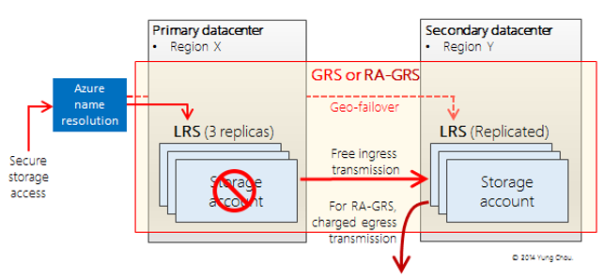
Azure Storage - Redundancy
Locally Redundant Storage (LRS)
Geo-Redundant Storage (GRS)
Read-Access Geo-Redundant Storage (RA-GRS)
Zone-Redundant Storage (ZRS)
Notes:
Locally Redundant Storage (LRS) Azure Storage provides high availability by ensuring that three copies of all data are made synchronously before a write is deemed successful. These copies are stored in a single facility in a single region. The replicas reside in separate fault domains and upgrade domains. This means the data is available even if a storage node holding your data fails or is taken offline to be updated. When you make a request to update storage, Azure sends the request to all three replicas and waits for successful responses for all of them before responding to you. This means that the copies in the primary region are always in sync. LRS is less expensive than GRS, and it also offers higher throughput. If your application stores data that can be easily reconstructed, you may opt for LRS.
Geo-Redundant Storage (GRS) GRS makes three synchronous copies of the data in the primary region for high availability, and then it asynchronously makes three replicas in a paired region for disaster recovery. Each Azure region has a defined paired region within the same geopolitical boundary for GRS. For example, West US is paired with East US. This has a small impact on scalability targets for the storage account. The GRS copies in the paired region are not accessible to you, and GRS is best viewed as disaster recovery for Microsoft rather than for you. In the event of a major failure in the primary region, Microsoft would make the GRS replicas available, but this has never happened to date.
Read-Access Geo-Redundant Storage (RA-GRS) This is GRS plus the ability to read the data in the secondary region, which makes it suitable for partial customer disaster recovery. If there is a problem with the primary region, you can change your application to have read-only access to the paired region. The storage client library supports a fallback mechanism via Microsoft.WindowsAzure.Storage.RetryPolicies.LocationMode to try to read from the secondary copy if the primary copy can’t be reached. This feature is built in for you. Your customers might not be able to perform updates, but at least the data is still available for viewing, reporting, etc. You also can use this if you have an application in which only a few users can write to the data but many people read the data. You can point your application that writes the data to the primary region but have the people only reading the data access the paired region. This is a good way to spread out the performance when accessing a storage account.
Zone-Redundant Storage (ZRS) This option can only be used for block blobs in a standard storage account. It replicates your data across two to three facilities, either within a single region or across two regions. This provides higher durability than LRS, but ZRS accounts do not have metrics or logging capability.

Slide 38
Scenario: Query-able Relational Database (PaaS) in cloud for transactional apps
Transactional scenarios need to use RDBS
RDBM on cloud needs to
dynamically scale
transactional processing
PaaS service, hence no infrastructure management
High availability
Business continuity and Disaster Recovery

Slide 39
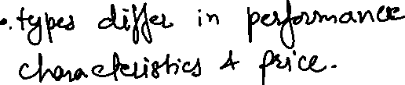

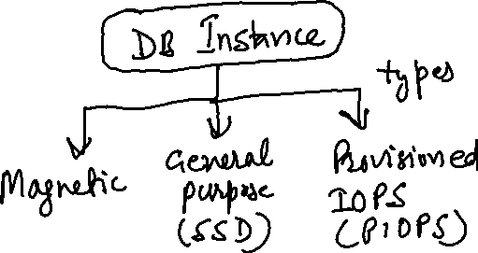
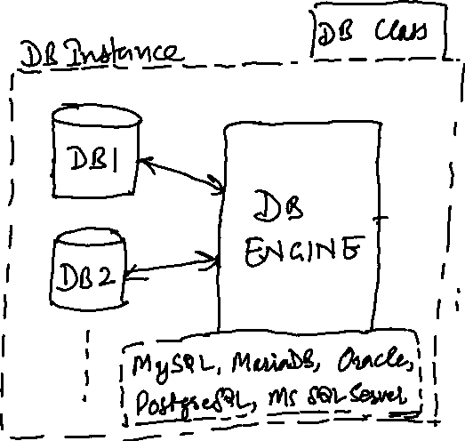
AWS Solution: AWS RDS (Relational Database Services)

Slide 40
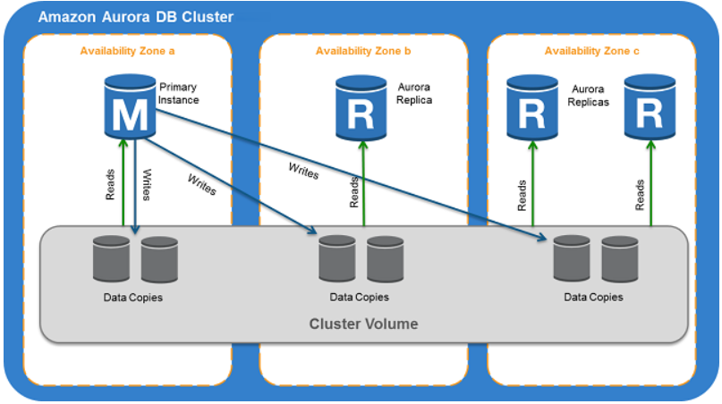
AWS Aurora – PaaS DB Service
Fully managed, MySQL- and PostgreSQL-compatible, relational database engine.
DB cluster defines one or more DB instances + a cluster volume spanning different AZs.
End points – cluster, reader and instance.
Notes:
A cluster endpoint is an endpoint for an Aurora DB cluster that connects to the current primary instance for that DB cluster. Each Aurora DB cluster has a cluster endpoint and one primary instance. The cluster endpoint provides failover support for read/write connections to the DB cluster. Use the cluster endpoint for CRUD operations, including queries.
A reader endpoint is an endpoint for an Aurora DB cluster that connects to one of the available Aurora Replicas for that DB cluster. The reader endpoint provides load balancing support for read-only connections to the DB cluster, not individual queries.
An instance endpoint is an endpoint for a DB instance in an Aurora DB cluster that connects to that specific DB instance. The instance endpoint provides direct control over connections to the DB cluster, e.g. for query level load balancing.

Slide 41
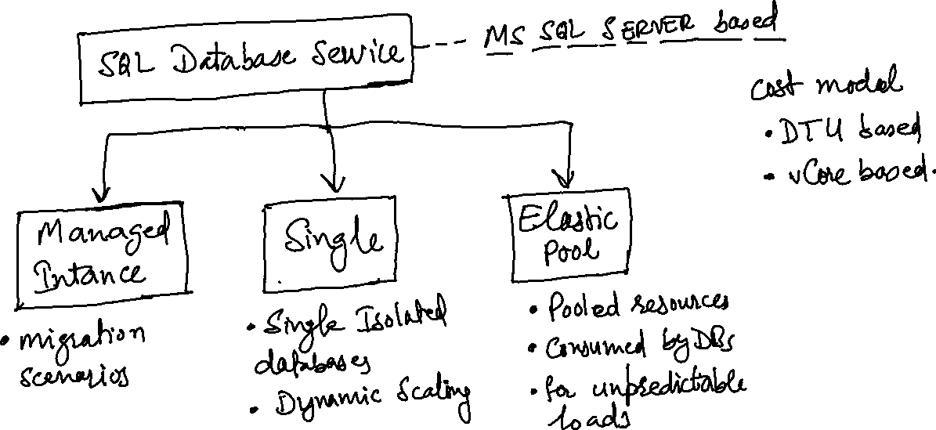
Azure Solution: SQL Database service
Notes:
Single db – its own set of resources managed via a logical server
Elastic pool – a pooled database in an elastic pool with a shared set of resources managed via a logical server
Managed Instance – a collection of databases that contains system and user databases and sharing set of resources
DTU – Database Throughput Unit
Azure also has separate managed services for MySQL and PostgreSQL

Slide 42
Scenario: NoSQL Databases in Cloud
Motivation to use NoSQL DBs
Bigness
NoSQL is key part of new data stack supporting big data – big number of users, big number of computers, big supply chains, big science and so on.
Data stored all around in a distributed manner does not fit well with RDBMS
High Volume
FB needs to store 135 billions messages a month, Twitter has problem of storing 7 TB data per day.
All such data needs to be distributed
Fast Key-Value access
Most NoSQL solutions provide hashing on a key and reading its value directly from the memory.
Flexible Schema and Flexible Data types
NoSQL products support a whole range of new data types
Complex objects can be easily stored without a lot of mapping.
Lack of structure allows much more flexibility
Notes:
http://highscalability.com/blog/2010/12/6/what-the-heck-are-you-actually-using-nosql-for.html

Slide 43
Cost of using NoSQL
Things taken for granted in RDBMS –
Transactional atomic writes
Indexing of non-key columns
Query optimizing
Declarative set oriented queries
– are sacrificed in NoSQL.
NoSQL – Provides AP of the CAP theorem – i.e. Consistency is sacrificed.
SQL – Provides CA of the CAP theorem – Partition tolerance is sacrificed.

Slide 44
Categories of NoSQL DBs
Key-Value Stores
Data stored in key and value pairs
Document Stores
Stored record is a ‘document’
Wide Column Stores
Semi-schematized and semi-hierarchical
Graph Databases
Explicitly track relationship between entities

Slide 45
Key Value stores
Structure of one record can differ from other in the same collection
This concept is basis of other NoSQL categories as well
Cache like speed and simpler data
most of the data is non-hierarchical – so RDBMS is not required for such data
Data is simple, but storage technology mush be more capable
Repos are distributed
Fault tolerance
Fast
Highly available
Examples
Azure Table Storage
Memcached DB
Voldmort of linked-in

Slide 46
Document Stores
A record is a ‘document’
Each document is a set of Key-Values
JSON Object <-> Document for many NoSQL DBs
Supports Versioning
Documents have URLs, therefore, REST friendly
HTTP orientation of Document Stores –
CouchDB has Show functions that return HTML
HTML is stored in ‘design’ documents
Each show function is accessible via URL
So, entire app could be implemented in a Document DB
Examples
Azure Document DB (Now subsumed in Cosmos DB)
Apache Couch DB
Amazon Dynamo DB
Open Source Mongo DB

Slide 47
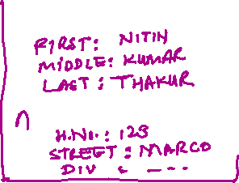
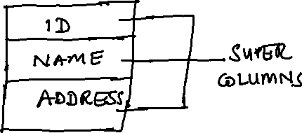
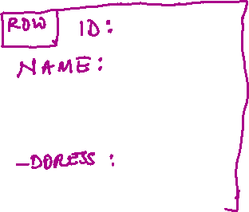
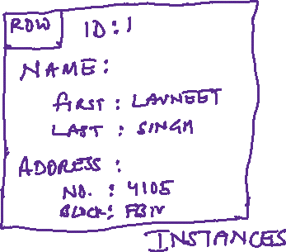
Wide Column Stores
Semi-structured and Semi-hierarchical
Also called Column Family stores
Table Name – Super Column Family
Super Columns
Column 1
Column 2
schema is defined
schema free
Notes:
e.g. Apache Cassandra, HyperTable, Apache Hbase, Google BigTable

Slide 48
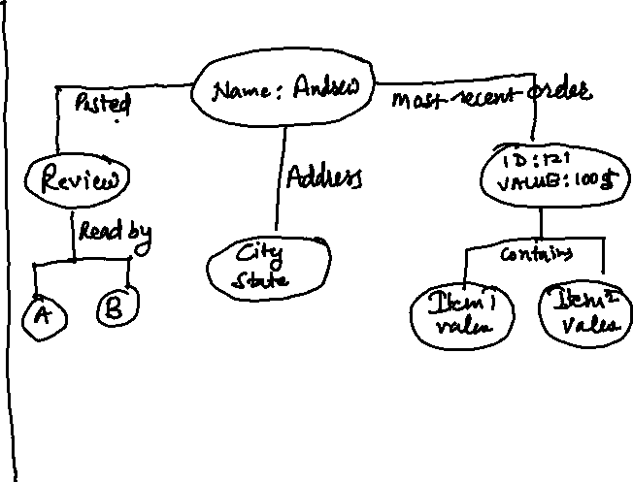
Graph Databases
Explicitly track relationships between entities
e.g. Chris City Auckland
Examples
Allegro Graph
Neo4j
Twitter’s Flock DB
Relation
Node 1
Node 2

Slide 49

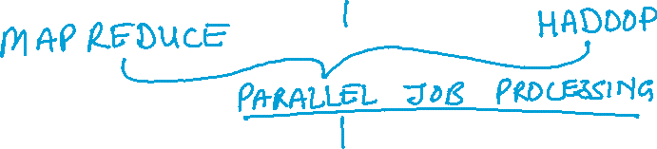
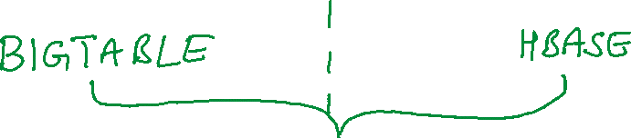
NoSQL – Common Traits
GOOGLE
APACHE / OPEN SOURCE

Slide 50
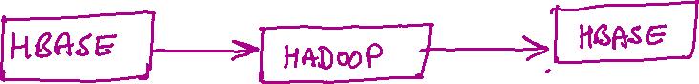


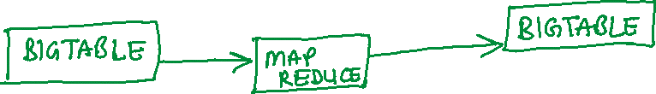


Slide 51
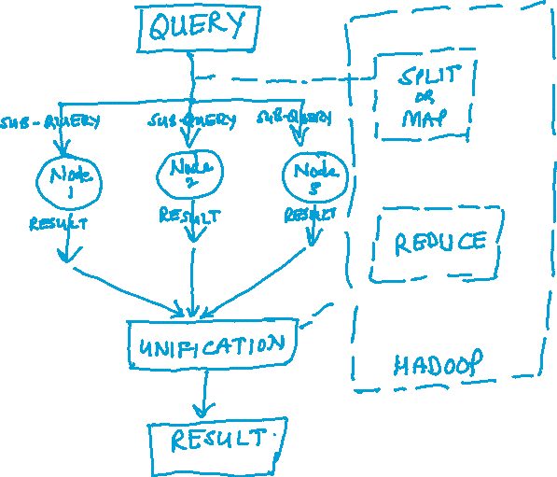
Why Parallel Job Processing Engines?
Querying NoSQL is less straightforward than RDBMS
data is stored in less structured way
data stored is distributed
Queries are therefore broken up and executed across multiple repos on different servers
Sub-query’s results need to be collected and unified

Slide 52
Common Consistency Models
Eventual Consistency
Changes made in one replica will be transmitted to others in asynchronous manner
There is propagation delay which might fetch older data
Eventually, the queries will find the correct data
Optimistic Concurrency
No locking of rows by single user
In low contention of data scenarios
No persistency connection to db server needed
DB servers free to serve large number of users in lesser time
Buffered Writes
Writes in aggregates
Notes:
Pessimistic concurrency involves locking rows at the data source to prevent other users from modifying data in a way that affects the current user
when a user performs an action that causes a lock to be applied, other users cannot perform actions that would conflict with the lock until the lock owner releases it.
primarily used in environments where there is heavy contention for data

Slide 53
Common NoSQL Indexing Models
Most of the NoSQL databases index on keys used for rows / entities / documents and / or partitions
CouchDB indexes Views as well
Allegro Graph indexes everything (Id, Subject, Predicate, Object & groups)
Some NoSQL DBs provide indexing on secondary columns
Cassandra

Slide 54
Common NoSQL upsides / advantages
Light weight, low friction
easy provisioning, deployment
quick availability due to non-schematic characteristics
devs can start coding against NoSQL due to REST / HTTP based API
Minimalistic Tools requirement
Browser UI serves the purpose
Sharding & Replication
Horizontal partitioning & fan-out queries
Geographic content replication
Web developer friendliness
Cross platform / device operation

Slide 55
NoSQL in Azure – Cosmos DB
globally distributed, multi-model database service for mission-critical applications
elastic scaling of throughput and storage worldwide
single digit millisecond latencies at 99th percentile
five well defined consistency models
guaranteed high availability
comprehensive SLAs
automatically indexes all data without requiring schema or indexing management
multi-model service – supports document, key-value, graph and wide column-family data models
Notes:
Single site databases offering Geo-DR capability are a strict subset of globally distributed databases.

Slide 56

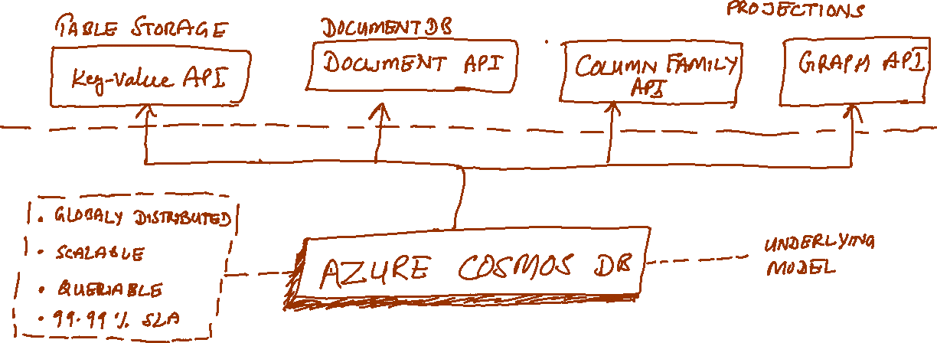

Cosmos DB API

Slide 57
Features of Cosmos DB
Associate unlimited number of regions with Cosmos DB account
Policy based geo-fencing
Failover priorities for regions
Dynamically configurable read and write regions
Geo-local reads and writes
Multi-homing
Well defined consistency models
Notes:
https://docs.microsoft.com/en-us/azure/cosmos-db/distribute-data-globally
To serve a read request, the quorum local to the region in which the read is issued is used. The same applies to writes. A write is acknowledged only after a majority of replicas have durably committed the write locally but without being gated on remote replicas to acknowledge the writes.
Multi-homing interact with a database using either logical (region-agnostic) or physical (region-specific) endpoints.

Slide 58
Consistency Models in Cosmos DB
Strong
Linearizability. Reads are guaranteed to return the most recent version of an item.
Bounded Staleness
Consistent Prefix. Reads lag behind writes by at most k prefixes or t interval
Session
Consistent Prefix. Monotonic reads, monotonic writes, read-your-writes, write-follows-reads
Consistent Prefix
Updates returned are some prefix of all the updates, with no gaps
Eventual
Out of order reads
Notes:
Commercial distributed databases fall into two categories: databases that do not offer well-defined provable consistency choices at all, and databases that offer two extreme programmability choices (strong vs. eventual consistency).
Despite the abundance of research and proposals for more than 50 consistency models, the distributed database community has not been able to commercialize consistency levels beyond strong and eventual consistency.

Slide 59
Strong Consistency
Strong consistency offers a linearizability guarantee with the reads guaranteed to return the most recent version of an item.
Strong consistency guarantees that a write is only visible after it is committed durably by the majority quorum of replicas. A write is either synchronously committed durably by both the primary and the quorum of secondaries, or it is aborted. A read is always acknowledged by the majority read quorum, a client can never see an uncommitted or partial write and is always guaranteed to read the latest acknowledged write.
Azure Cosmos DB accounts that are configured to use strong consistency cannot associate more than one Azure region with their Azure Cosmos DB account.
The cost of a read operation (in terms of request units consumed) with strong consistency is higher than session and eventual, but the same as bounded staleness.

Slide 60
Bounded staleness Consistency
Bounded staleness consistency guarantees that the reads may lag behind writes by at most K versions or prefixes of an item or t time-interval.
Therefore, when choosing bounded staleness, the "staleness" can be configured in two ways: number of versions K of the item by which the reads lag behind the writes, and the time interval t
Bounded staleness offers total global order except within the "staleness window." The monotonic read guarantees exist within a region both inside and outside the "staleness window."
Bounded staleness provides a stronger consistency guarantee than session, consistent-prefix, or eventual consistency. For globally distributed applications, use bounded staleness for scenarios where you would like to have strong consistency but also want 99.99% availability and low latency.
Azure Cosmos DB accounts that are configured with bounded staleness consistency can associate any number of Azure regions with their Azure Cosmos DB account.
The cost of a read operation (in terms of RUs consumed) with bounded staleness is higher than session and eventual consistency, but the same as strong consistency.

Slide 61
Session Consistency
Unlike the global consistency models offered by strong and bounded staleness consistency levels, session consistency is scoped to a client session.
Session consistency is ideal for all scenarios where a device or user session is involved since it guarantees monotonic reads, monotonic writes, and read your own writes (RYW) guarantees.
Session consistency provides predictable consistency for a session, and maximum read throughput while offering the lowest latency writes and reads.
Azure Cosmos DB accounts that are configured with session consistency can associate any number of Azure regions with their Azure Cosmos DB account.
The cost of a read operation (in terms of RUs consumed) with session consistency level is less than strong and bounded staleness, but more than eventual consistency.

Slide 62
Consistent Prefix Consistency
Consistent prefix guarantees that in absence of any further writes, the replicas within the group eventually converge.
Consistent prefix guarantees that reads never see out of order writes. If writes were performed in the order A, B, C, then a client sees either A, A,B, or A,B,C, but never out of order like A,C or B,A,C.
Azure Cosmos DB accounts that are configured with consistent prefix consistency can associate any number of Azure regions with their Azure Cosmos DB account.

Slide 63
Eventual Consistency
Eventual consistency guarantees that in absence of any further writes, the replicas within the group eventually converge.
Eventual consistency is the weakest form of consistency where a client may get the values that are older than the ones it had seen before.
Eventual consistency provides the weakest read consistency but offers the lowest latency for both reads and writes.
Azure Cosmos DB accounts that are configured with eventual consistency can associate any number of Azure regions with their Azure Cosmos DB account.
The cost of a read operation (in terms of RUs consumed) with the eventual consistency level is the lowest of all the Azure Cosmos DB consistency levels.

Slide 64
A technical overview of Azure Cosmos DB
The core type system of Azure Cosmos DB’s database engine is atom-record-sequence (ARS) based
Atoms consist of a small set of primitive types e.g. string, bool, number etc.
Records are structs
Sequences are arrays consisting of atoms, records or sequences
The database engine of Azure Cosmos DB
is capable of efficiently translating and projecting the data models onto the ARS based data model
The core data model is natively accessible from dynamically typed programming languages and can be exposed as-is using JSON or other similar representations.

Slide 65
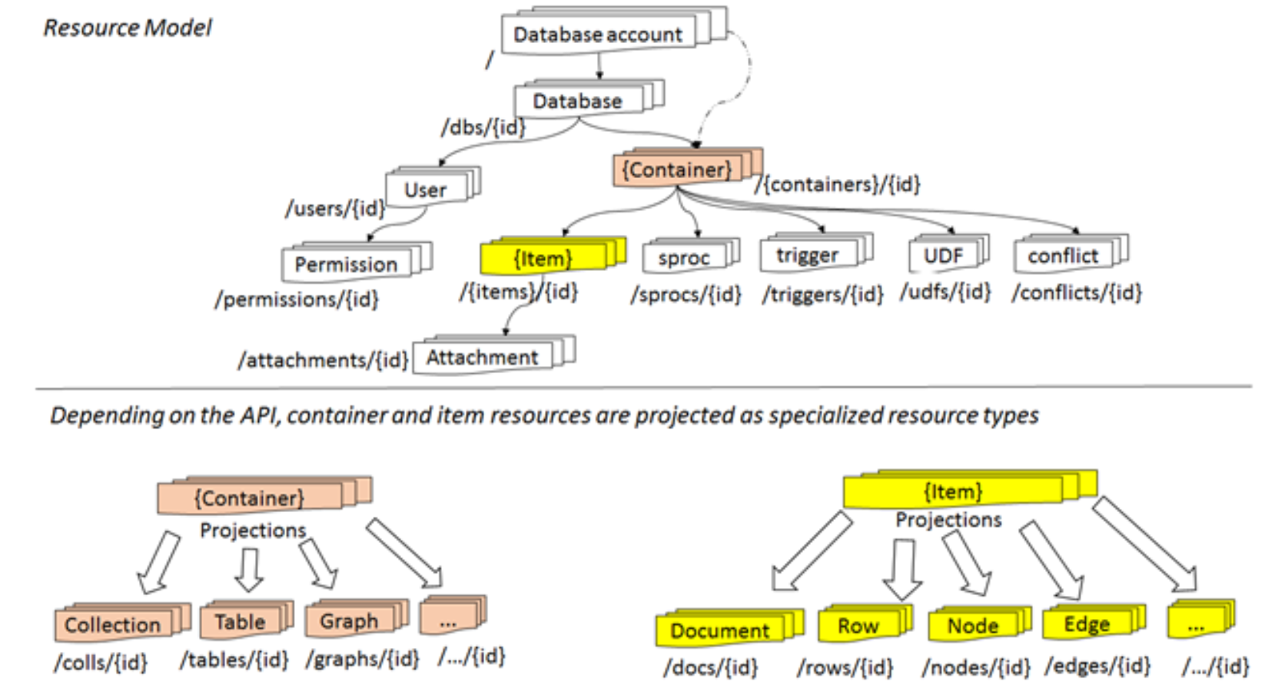






Resource Model and API Projections
Notes:
https://azure.microsoft.com/en-us/blog/a-technical-overview-of-azure-cosmos-db/
The overall resource model of an application using Azure Cosmos DB is a hierarchical overlay of the resources rooted under the database account, and can be navigated using hyperlinks.
With the exception of the item resource - which is used to represent arbitrary user defined content, all other resources have a system-defined schema.
The content model of the item resource is based on atom-record-sequence (ARS) described earlier.
Both, container and item resources are further projected as reified resource types for a specific type of API interface
Each resource is uniquely identified by a stable and logical URI and represented as a JSON document.

Slide 66
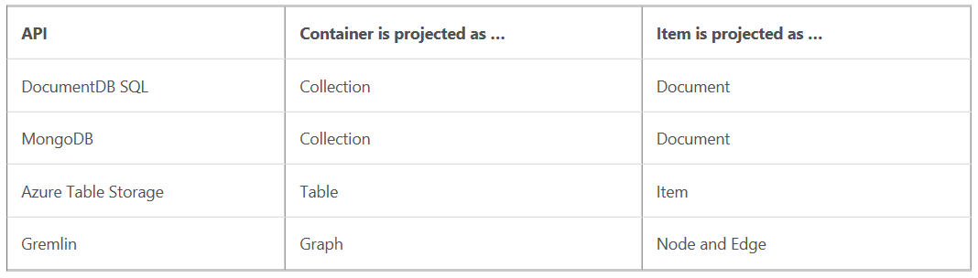
The overall resource model of an application using Azure Cosmos DB is a hierarchical overlay of the resources rooted under the database account, and can be navigated using hyperlinks.
With the exception of the item resource - which is used to represent arbitrary user defined content, all other resources have a system-defined schema.
The content model of the item resource is based on atom-record-sequence (ARS) described earlier.
Both, container and item resources are further projected as reified resource types for a specific type of API interface

Slide 67
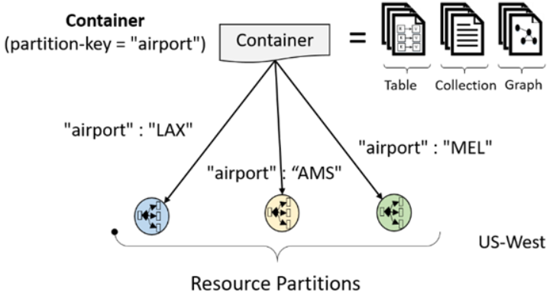
Horizontal Partitioning
All the data within an Azure Cosmos DB container (e.g. collection, table, graph etc.) is horizontally partitioned and transparently managed by resource partitions
Notes:
A resource partition is a consistent and highly available container of data partitioned by a customer specified partition-key
it provides a single system image for a set of resources it manages and is a fundamental unit of scalability and distribution
Customers can elastically scale throughput of a container by programmatically provisioning throughput at a second or minute granularity on an Azure Cosmos DB container.

Slide 68
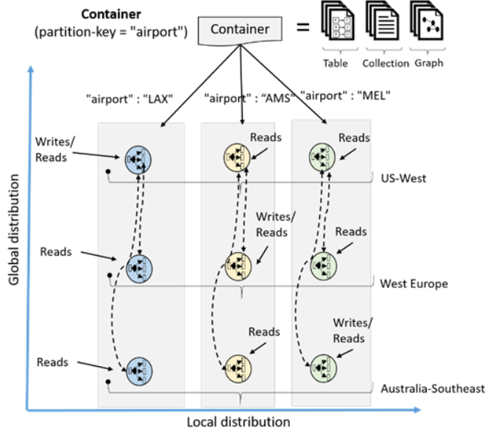
Global distribution
a customer’s resources are distributed along two dimensions: within a given region, all resources are horizontally partitioned using resource partitions (local distribution).
Each resource partition is also replicated across geographical regions (global distribution).
Currency
RUs (Request Units)
RUs/sec or RUs/minute

Slide 69
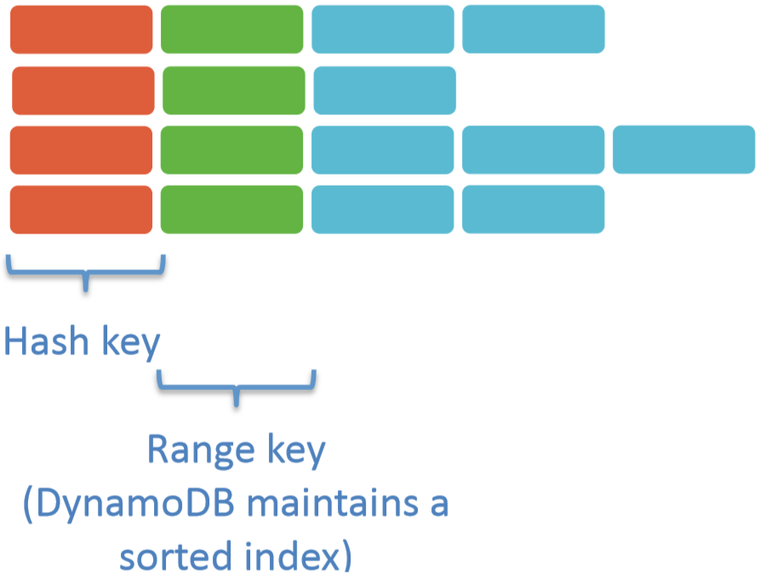
AWS NoSQL - DynamoDB
DynamoDB organizes data into tables consisting of items.
Each item in a DynamoDB table can define an arbitrary set of attributes, but all items in the table must define a primary key that uniquely identifies the item.
This key must contain an attribute known as the “hash key” and optionally an attribute called the “range key.”
Notes:
https://d0.awsstatic.com/whitepapers/migration-best-practices-rdbms-to-dynamodb.pdf
Often, it is useful to be able to fetch items using a different set of values than the hash and the range keys. DynamoDB supports these operations through local and global secondary indexes. A local secondary index uses the same hash key as defined on the table, but a different attribute as the range key.
A global secondary index can use any scalar attribute as the hash or range key
Reads on global secondary indexes are always eventually consistent, whereas local secondary indexes support eventual or strong consistency.

Slide 70
IoT Application Architecture

Slide 71
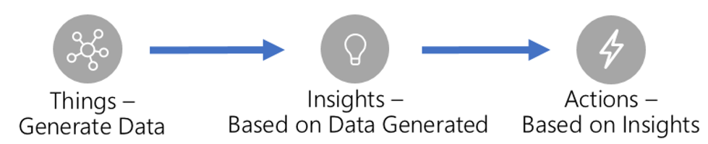
Internet of Things (IoT)
IoT applications can be described as Things (or devices), sending data or events that are used to generate Insights, which are used to generate Actions to help improve a business or process.
END GOAL: Taking action on business insights found through gathering data from assets
Notes:
https://aka.ms/iotrefarchitecture

Slide 72
IoT Systems – Technology Selection Criteria
Security
user management and auditing, device connectivity, in-transit telemetry, and at rest security
Simplicity
Performance
Scale
should support millions of connected devices
HA/DR
Cost

Slide 73
Architecture Overview
IoT application should be built as discrete services that are independently deployable, and able to scale independently
Cloud native, Microservice, Serverless
It is critical to have the ability to monitor individual subsystems as well as the IoT application as a whole
subsystems communicate over REST/HTTPS using JSON (as it is human readable) though binary protocols should be used for high performance needs
Hybrid cloud and edge compute strategy
some data processing is expected to happen on premise
Horizontal Scalability
User services that can scale subsystems horizontally e.g. Azure App Service, Azure Managed Kubernetes or Service Fabric

Slide 74
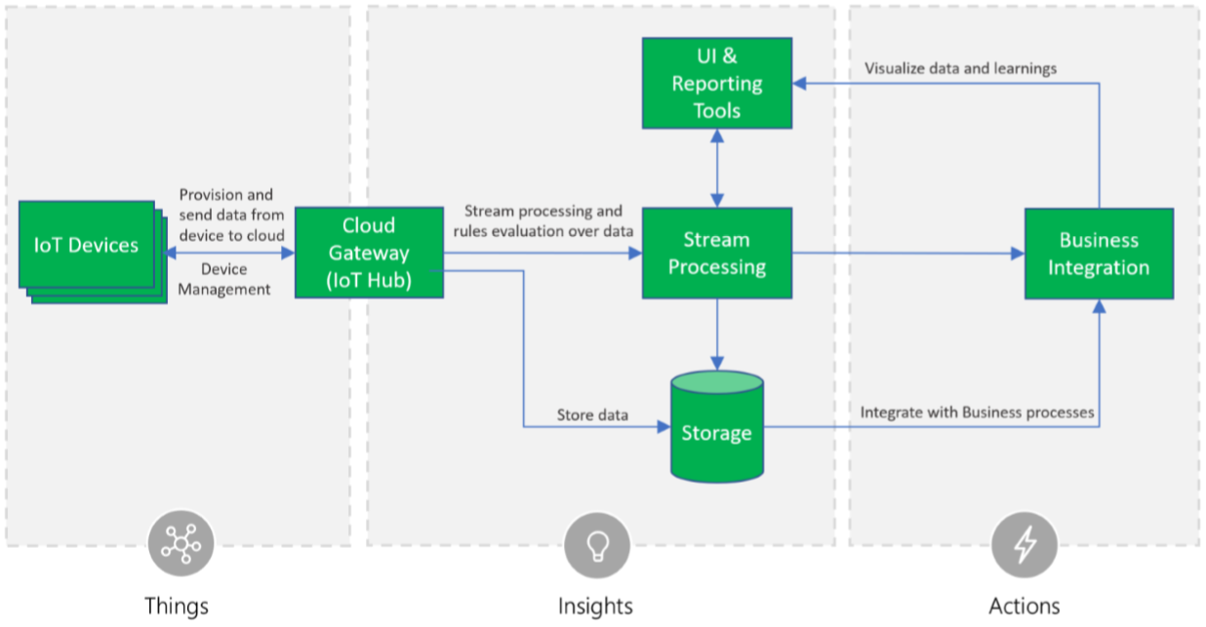
IoT System – Core Subsystems

Slide 75
Devices (and/or on premise edge gateways) that have
the ability to securely register with the cloud
connectivity options for sending and receiving data with the cloud
A cloud gateway service, or hub, to securely accept that data and provide device management capabilities
Stream processors that
consume that data
integrate with business processes
place the data into storage
User interface to visualize telemetry data and facilitate device management.

Slide 76
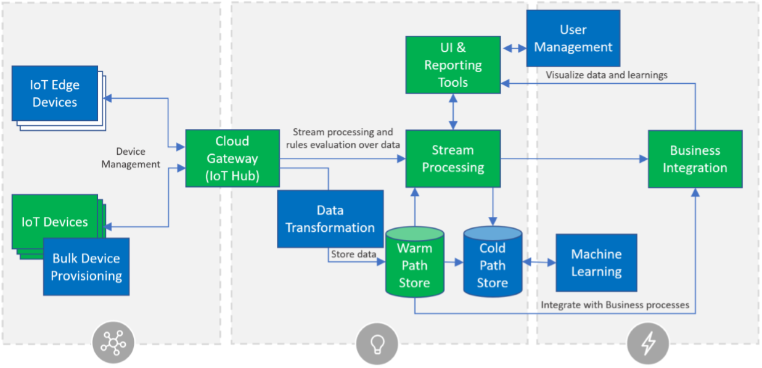
Additional Subsystems

Slide 77
Storage can be divided into
warm path - data that is required to be available for reporting and visualization immediately from devices
cold path - data that is stored longer term and used for batch processing
Data transformation
manipulation or aggregation of the telemetry stream either before or after it is received by the cloud gateway service (the IoT Hub)
Manipulation can include protocol transformation (e.g. converting binary streamed data to JSON), combining data points, and more
The machine learning (ML) subsystem enables systems to
learn from data and experiences and to act without being explicitly programmed
Scenarios such as predictive maintenance are enabled through ML
The user management subsystem allows
specification of different capabilities for users and groups to perform actions on devices (e.g. command and control such as upgrading firmware for a device)
capabilities for users in applications.

Slide 78
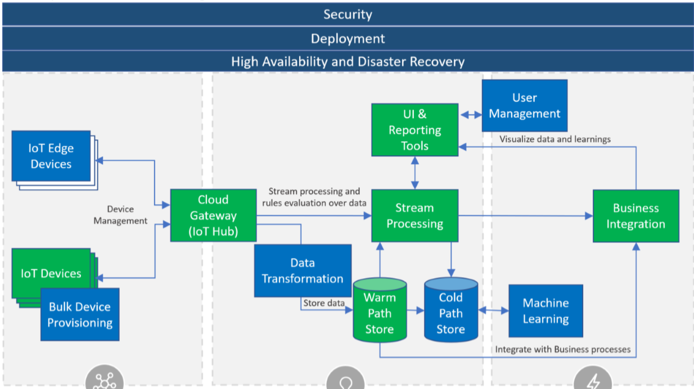
Cross-cutting Application Needs
+ Logging & Monitoring

Slide 79
Security is a critical consideration in each of the subsystems
secure provisioning of devices
secure connectivity between devices, edge devices, and the cloud
secure access to the backend solutions
secure data protection in the cloud during processing and storage (encryption at rest).
Logging and monitoring for IoT application is critical determining system uptime and troubleshooting failures.
High availability and disaster recovery (HA/DR) focuses on ensuring an IoT system is always available, including from failures resulting from disasters
subsystems have different failover and cross-region support characteristics

Slide 80
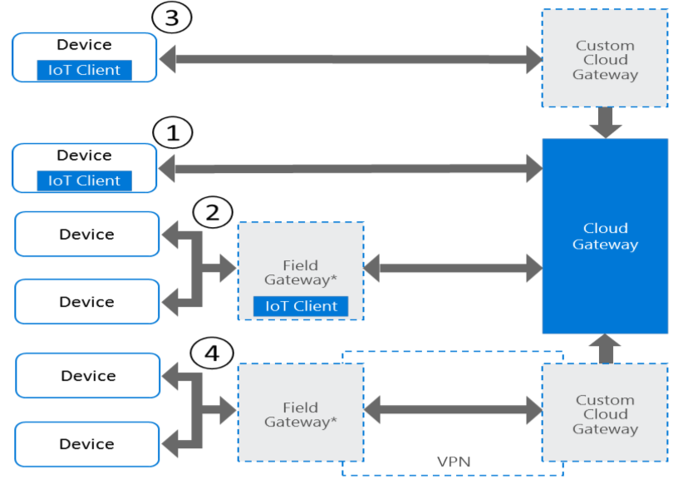
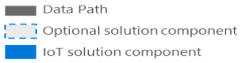
Devices, Device Connectivity, Field Gateway (Edge Device), Cloud Gateway
Direct device connectivity to the cloud gateway
Connectivity via a field gateway (IoT Edge Device)
Connectivity via a custom cloud gateway
Connectivity via a field gateway and a custom cloud gateway
Technology Options:
Azure IoT device SDKs
Notes:
: For IP capable devices that can establish secure connections via the Internet
: For devices using industry specific protocols (such as CoAP5, OPC), short-range communication technologies (such as Bluetooth, ZigBee), as well as for resource-constrained devices not capable of hosting a TLS/SSL stack, or devices not exposed to the Internet. This option is also useful when aggregation of streams and data is executed on a field gateway before transferring to the cloud.
: For devices that require protocol translation or some form of custom processing before reaching the cloud gateway communication endpoint
Similar to the previous pattern, field gateway scenarios might require some protocol adaption or customizations on the cloud side and therefore can choose to connect to a custom gateway running in the cloud. Some scenarios require integration of field and cloud gateways using isolated network tunnels, either using VPN technology or using an application-level relay service.

Slide 81
Field Gateway
acts as a - communication enabler, local device control system, device data processing hub
can perform local processing and control functions toward the devices
can filter or aggregate the device telemetry and thus reduce the amount of data being transferred to the cloud backend
Cloud Gateway
A cloud gateway is the part of the cloud-based architecture
Enables remote communication to and from devices or field gateways which could reside at several different sites
Notes:
A field gateway’s scope includes the field gateway itself and all devices that are attached to it. As the name implies, field gateways act outside dedicated data processing facilities and are usually collocated with the devices.
A field gateway is different from a mere traffic router in that it has an active role in managing access and information flow. It is an application-addressed entity and network connection or session terminal. For example, gateways in this context may assist in device provisioning, data filtering, batching and aggregation, buffering of data, protocol translation, and event rules processing. NAT devices or firewalls, in contrast, do not qualify as field gateways since they are not explicit connection or session terminals, but rather route (or deny) connections or sessions made through them

Slide 82
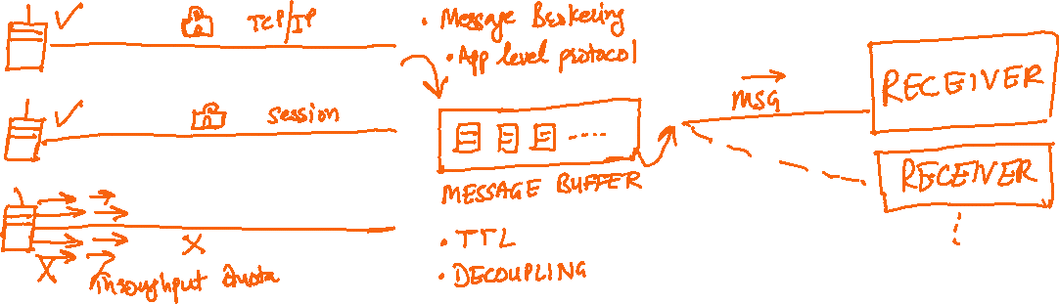
A cloud gateway will either be reachable over
the public Internet
a network virtualization overlay (VPN)
private network connections into Azure data centers
Notes:
to insulate the cloud gateway and all of its attached devices or field gateways from another network traffic
“inbox pattern”

Slide 83
Cloud Gateway – Technology options
Azure IoT Hub
high-scale service enabling secure bidirectional communication from a variety of device
connects millions of devices and supports high-volume telemetry ingestion to a cloud backend as well as command and control traffic to devices
supports multiple consumers for cloud ingestion as well as the inbox pattern for devices
support for the AMQP 1.0 with optional WebSocket6 support, MQTT 3.1.17, and native HTTP 1.1 over TLS protocols
includes a built-in device identity store that is the authority for registered devices and provides per-device security credentials
use the Azure IoT Hub Device Provisioning Service (DPS) for device provisioning

Slide 84
Storage
IoT solutions can generate significant amounts of data depending upon
how many devices are in the solution
how often they send data
the size of payload in the data records sent from devices
Data is often time stamped and required to be stored where it can be accessed for further processing and used in visualization and reporting
Common to have data split into “warm” and "cold" data stores
The warm data store holds recent data that needs to be accessed with low latency
Data stored in cold storage is typically historical data
Notes:
Most often the cold storage database technology chosen will be cheaper in cost but offer fewer query and reporting features than the warm database solution

Slide 85
Storage – Technology options
For general purpose scenarios
Azure Cosmos DB for warm storage
Azure Blob Storage for cold storage
If the solution requires frequent queries that involve aggregation across many events across many devices
Azure Time Series Insights for warm storage

Slide 86
Cloud Messaging Services
Notes:
https://www.youtube.com/watch?v=SG0tn4pUvy8&t=140s

Slide 87
Messaging Services
Used for machine – machine and/or service – service communication
Provides decoupling between producers of messages and consumers of messages
Data streaming, ingestion and retention scenarios
Connectivity between on-premise and cloud scenarios
Key glue that enables loosely coupled and distributed cloud based solutions

Slide 88
Where messaging services are used?
Financial Services
Utilities & Telecom
Logistics
Insurance
Healthcare
Government
Order processing
eCommerce
Delivery Notifications
Inventory Management
Routing
Medical Records
Care quality metrics
Patient monitoring & diagnostics
Enrolment
Claims processing
Risk Modelling
Regulatory filing
Inter-bank transfers
Order fulfilment & trading
Settlement
Reconciliation
Pricing and Quote Updates
Customer Information Systems
Billing integration
Smart meter & grid
Command & control

Slide 89
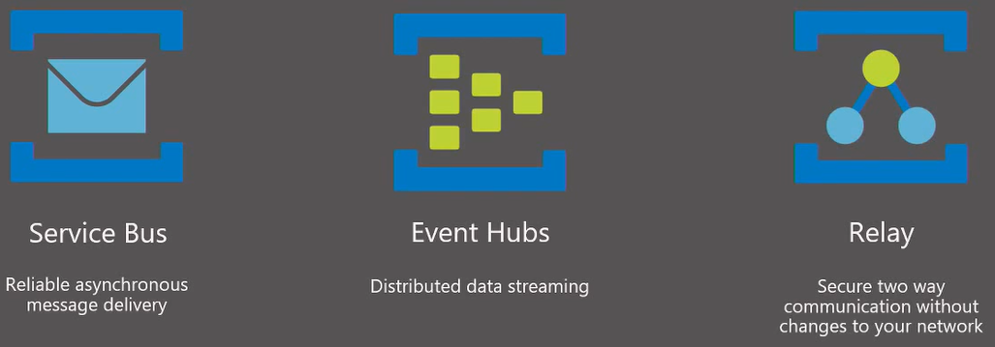
Azure Messaging Services

Slide 90
Azure Service Bus
Messaging as a service
Queues and Topics
Reliable asynchronous communication
Rich features for temporal control
Routing and filtering
Convoys & Sessions (related message with state)

Slide 91

Where does Service bus fit in?
Decoupling and providing durability are primary drivers for using service bus

Slide 92

Service Bus - Common messaging patterns
Notes:
https://www.youtube.com/watch?v=82akIKoX09A&t=14s

Slide 93

Features of Service Bus

Slide 94

Topics & Subscriptions
Sender knows only about Topic
Receivers know only about Subscription
Filters and Actions exist on Subscription
Notes:
version based gradual upgrade scenario using topics: create filters based on version of message. When new version of system is ready add its subscription to topic and let it handle v2 messages. v1 messages can continue to go to v1 subscription for as long as one wants.

Slide 95
Cloud App Services (PaaS)

Slide 96
Azure – App Service
PaaS service for hosting web applications, REST APIs and mobile back-ends
Web Apps adds cloud features to application, such as security, load balancing, autoscaling, and automated management.
Take advantage of its DevOps capabilities, such as continuous deployment from VSTS, GitHub, Docker Hub, and other sources, package management, staging environments, custom domain, and SSL certificates.
With App Service, pay for the Azure compute resources you use. The compute resources you use is determined by the App Service plan that you run your Web Apps on

Slide 97

App Service Plan
In App Service, an app runs in an App Service plan.
An App Service plan defines a set of compute resources for a web app to run
One or more apps can be configured to run on the same computing resources (or in the same App Service plan).
Notes:
When you create an App Service plan in a certain region (for example, West Europe), a set of compute resources is created for that plan in that region. Whatever apps you put into this App Service plan run on these compute resources as defined by your App Service plan.

Slide 98

Each App Service plan defines
Region (West US, East US, etc.)
Number of VM instances
Size of VM instances (Small, Medium, Large)
Pricing tier (Free, Shared, Basic, Standard, Premium, Premium V2, Isolated, Consumption)

Slide 99


Running the app
In the Free and Shared tiers, an app receives CPU minutes on a shared VM instance and cannot scale out.

Slide 100


Scaling the app
the App Service plan is the scale unit of the App Service apps
If the plan is configured to run five VM instances, then all apps in the plan run on all five instances
If the plan is configured for autoscaling, then all apps in the plan are scaled out together based on the autoscale settings

Slide 101
Identity and Security in Cloud
Notes:
Includes Data Security

Slide 102
Cloud Identity & Security Solutions
Identity Solution
Azure AD, MFA, 3rd Party Identity Providers
Data Security Solution
Storage encryption, DB security capabilities, Protecting secrets
Governance & Policies for Administering resources
Azure RBAC, resource policies, PIM, HSM-backed keys
Management of Security Risks
Identify, assess & manage security risks, Ops Security & Audit solutions, End-point protection strategy
Notes:
PIM – Privileged Identity Management

Slide 103
CLOUD IDENTITY SOLUTION

Slide 104
Identity is the new control plane
Security
Identity is the beachhead for hackers and security and identity attacks have risen 300% in the last year alone.
Staying in control of your identity security has never been more important and cloud identity and access management is vital.
Hybrid Identity
Empower your org’s digital transformation by enabling a common identity across your on-premises and cloud-based applications and resources so they can be accessed securely and easily from anywhere.
Notes:
Identity is the center of how you secure your environment

Slide 105
Customer Identity
You want to engage with customers, but want to streamline the user account management and keep both their identities and your business protected.
With a cloud-based customer identity solution you can have the flexibility and scalability you need to stay connected with customers and support business objectives.
Identity for developers
Focus on building apps and websites and let the handle your authentication.
Leverage the cloud APIs for secure authentication and build more powerful experiences with the Cloud based solutions

Slide 106

Azure Active Directory (Azure AD)

Slide 107
What’s a directory service, and why do we need it?
a directory service is a container that provides a hierarchical structure in which to store objects for quick and easy access and manipulation.
Finding a file
Without directory service
With directory service
Know the file name
Know the server name/IP
i.e. the physical computer
Path to the containing folder
Know the file name
Know the directory service
Notes:
Before directory services, network resources were organized primarily by computer name, workgroup, or domain. If you needed a specific file, for example, you needed to know not only the name of the file but also the server on which it was stored and the path to its folder. If you needed to print to a specific printer, you needed to know the name of the server that managed the printer’s queue. On a small network, this type of structure works fine. As the network grows, however, finding and managing resources can be a challenge, particularly for inexperienced or casual users. A directory service like Active Directory is designed to simplify resource access and management.

Slide 108
Active Directory – Microsoft’s directory service
Distributed Security
SSO as answer to having multiple accounts & passwords
SSO using Kerberos authentication
Kerberos authenticates the credentials and issues the user a ticket with which the user gains access to the resources and services that support Kerberos.
User management
Different services often require different user credentials stored at different places
AD simplifies user management by acting as a single repository for all of this user- and computer-related information.
Notes:
Kerberos originated at MIT in the UNIX realm and is now a de facto standard supported by a wide range of operating system vendors including Microsoft, Apple, Sun, and Novell. SSO refers to Kerberos’ ability to provide a user with one set of credentials and grant them access across a range of resources and services with that same set of credentials.
Different services often require different user credentials or related user information, which often is stored in various places—the domain, member servers, the e-mail server, the voice mail system, and so on. In addition, effective management means applying appropriate restrictions to the tasks a user can perform. Because the typical business environment is dynamic, changes to user policies can occur often.
Rather than manage user credentials in several locations, you manage the credentials in one place—AD. Group policies that determine the rights and restrictions that apply to a user are also stored in AD, giving you a one-stop shop for administration

Slide 109
Distributed Administration
While AD centralizes information about resources, users, and computers, it decentralizes administration
AD’s structure is hierarchical and compartmentalized, which means specific services can be stored in their own containers or in containers with related objects
One can apply permissions to these containers within AD to define which administrators have access and their levels of access
One group can be fully responsible for mail services, another for user management, another for DNS servers, another for Web services, and so on, without having any permissions in the other administrative groups.
Naming Conventions
RFC 822 scheme (User Principal Names, UPN) e.g. user@domain
Resources and objects in AD are referred to by URI which are based on LDAP names. e.g. LDAP://ldap.techrepublic.com/cn=boyce,ou=support,dc=techrepublic,dc=com

Slide 110

Active Directory as DB
AD is a distributed database
The ESE comprises two tables that define the structure of the directory
The Database Layer includes three tables that define the contents of AD:
Schema table
Link table
Data table
Notes:
This database is designed in several layers that include the Core Directory Service Agent (DSA), Database Layer (DB), and Extensible Storage Engine (ESE). Above those layers lie the Security Account Manager (SAM), LDAP interface, and Replication layers
Schema table—This table defines the types of objects that can be created in the directory, how those objects relate to one another, and the mandatory and optional attributes of each object. In short, this table stores the directory’s schema (more on that later).
Link table—This table stores the data that defines how objects relate to one another in the database.
Data table—While the Schema table defines object structure, this table contains the object data. This includes such things as user accounts (names, login names, passwords, etc.), groups, application data, and so on.

Slide 111
Active Directory Objects
Objects in AD can be either containers for other objects or they can be leaf objects, which do not serve as containers
Objects in AD have attributes, and these attributes not only define the object but also store data.
For example, a user object would have a password property that stores the user’s password.
The user’s first name would be another property, as would be phone number.
The name of a domain is one of the domain object’s properties.
Some attributes are mandatory, while others are optional.
One attribute that is mandatory is the globally unique identifier, or GUID
Notes:
A good analogy for AD's structure in terms of its objects is the DNS name space and a typical file system. Both are object trees that have a root, and both have a hierarchical structure underneath the root. Using the file system analogy, container objects in AD are like folders in the file system—they can contain other folders or can contain files. The difference is that in AD an object can contain other containers or can contain leaf objects, but not both.
AD assigns a GUID, which is a 128-bit number, to an object when it is created. No two objects in AD have the same GUID. If an object is moved within AD, it retains its GUID, which enables it to be located even if it moves.

Slide 112
AD are protected by Access Control Lists (ACLs).
This provides for distributed administration by enabling one to assign permissions on objects to restrict the actions that individual users or groups can take on those objects
Active Directory Schema
A key element of AD is the schema. AD’s schema is the set of rules that define AD and the objects it contains.
When one creates objects in AD, those objects must conform to the schema, or they can’t be added
The schema controls object properties, naming structure, data types, object types and so on.

Slide 113
Azure Identity Solutions
Microsoft Azure Active Directory (Azure AD) is an identity and access management cloud solution that provides
directory services,
identity governance, and
application access management
A single Azure AD directory is automatically associated with an Azure subscription when it is created
As the identity service in Azure, Azure AD then provides all identity management and access control functions for cloud based resources.

Slide 114
Identity Solution: DIY AD DS
For companies that need only a small footprint in the cloud, do-it-yourself (DIY) AD DS in Azure can be used
Supports Windows Server AD DS scenarios that are well-suited for deployment as virtual machines (VMs) on Azure
DS DC in cloud
Substitute for DS DR
Isolated DS forest for cloud app
It’s also supported to deploy network applications that do require connectivity to the on-premises network and the on-premises Active Directory
Notes:
create an Azure VM as a domain controller running in a faraway datacenter that is connected to the remote network. From there, the VM would be able to support authentication requests from remote users and improve authentication performance
low-cost substitute to otherwise costly disaster recovery sites by hosting a small number of domain controllers and a single virtual network on Azure
deploy an application on Azure, such as SharePoint, that requires Windows Server AD DS, but has no dependency on the on-premises network or the corporate Windows Server Active Directory. In this case, you could deploy an isolated forest on Azure to meet the SharePoint server farm’s requirements.

Slide 115
Identity Solution: Azure AD
Azure AD Standalone
fully cloud-based Identity and access management as a Service (IDaaS) solution.
Azure AD gives you a robust set of capabilities to manage users and groups
Secure access to on-premises and SaaS applications.
Hybrid Identity
extending on-premises directories to the cloud through hybrid identity solutions
Azure AD Domain Services
a cloud-based option to use AD DS for lightweight Azure VM configuration control
on-premises identity requirements for network application development and testing

Slide 116


Slide 117
Identity Solution: Hybrid Identity
hybrid identity solutions enable you to synchronize on-premises directory objects with Azure AD while still managing your users on-premises
Options
Windows Server
AD DS
Sync
Azure AD
(on cloud)
Synchronized Identity
Federated Identity

Slide 118

Synchronized Identity
quickest way to synchronise on-premise directory objects with Azure AD
users still need to maintain a separate password for cloud-based resources – unless password hashes are synchronized as well
Azure AD Connect periodically checks your on-premises directory for changes and keeps your Azure AD directory synchronized

Slide 119

Synchronized Identity - Pass through authentication
Azure AD pass-through authentication provides a simple password validation solution for Azure AD-based services using company’s on-premises Active Directory
Supports desktop SSO for domain joined devices
When users sign in using Azure AD, this authentication method validates users' passwords directly against your on-premises Active Directory
Notes:
Pass-through authentication is configured with Azure AD Connect, which uses a simple on-premises agent that listens for password validation requests. The agent can be easily deployed to multiple machines to provide high availability and load balancing

Slide 120

Federated Identity (AD FS)
For more control over how users access Office 365 and other cloud services, you can set up directory synchronization with single sign-on (SSO) using Active Directory Federation Services (AD FS).
Federating your user's sign-ins with AD FS delegates authentication to an on-premises server that validates user credentials
In this model, on-premises Active Directory credentials are never passed to Azure AD.

Slide 121
This sign-in method ensures that all user authentication is controlled on-premises and allows administrators to implement more rigorous levels of access control.
Identity federation with AD FS is the most complicated option and requires deploying additional servers in your on-premises environment
Identity federation also commits you to providing 24x7 support for your Active Directory and AD FS infrastructure.
This high level of support is necessary because if your on-premises Internet access, domain controller, or AD FS servers are unavailable, users can't sign in to cloud services.
If you decide to use Federation with Active Directory Federation Services (AD FS), you can optionally set up password synchronization as a backup in case your AD FS infrastructure fails.

Slide 122




